Slide 1
Machine Learning with an Adversary
Geoff Hulten

Slide 2
Why do people Attack Systems?
Crime, espionage
For fun
To make money

Slide 3
Making Money off of Abuse
Driving traffic
Compromising personal information
Compromising computers
Boosting content
Suppressing content
Stealing content

Slide 4

Using machine learning to combat abuse
Find the interaction you don’t like
Get training data, label it
Build a model, measure the accuracy
Deploy it and…
If it hurts the abuser’s bottom line at all they will work around it in 5 minutes…

Slide 5

How to Work Around Machine Learning?
Get the model and test your content against it
Buy the client
Create test accounts on the service
Outlook story
Hotmail probe account story
The concept of abuse changes to be: whatever your model doesn’t think abuse is…

Slide 6
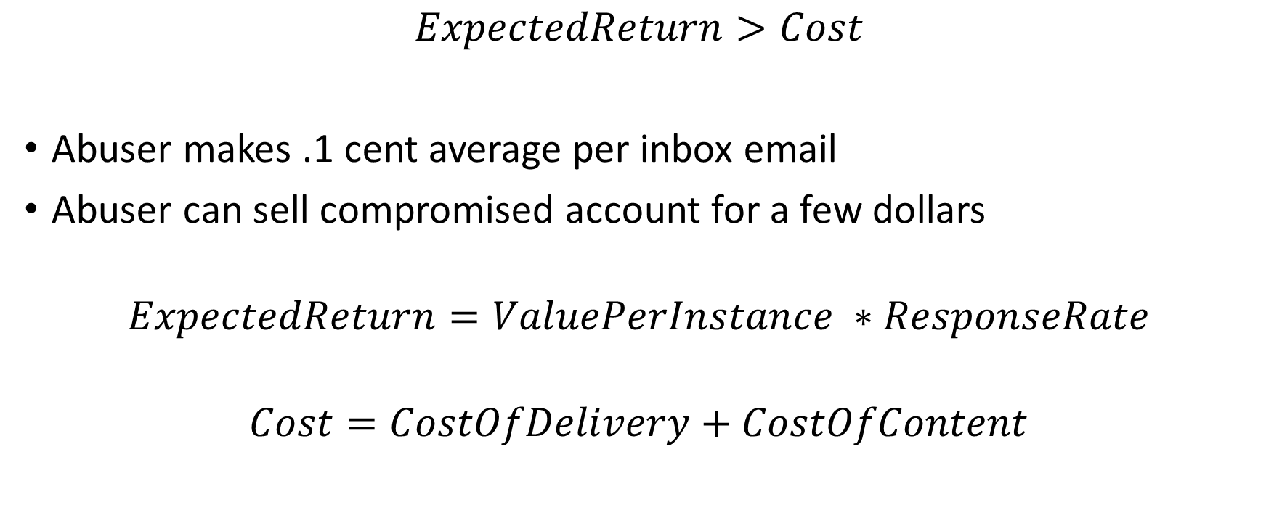
Abuse is a business
$$ExpectedReturn>Cost$$
Abuser makes .1 cent average per inbox email
Abuser can sell compromised account for a few dollars
$$ExpectedReturn=ValuePerInstance ∗ResponseRate$$
$$Cost=CostOfDelivery+CostOfContent$$

Slide 7
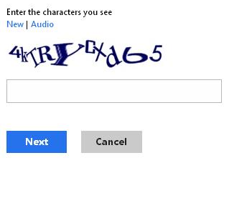
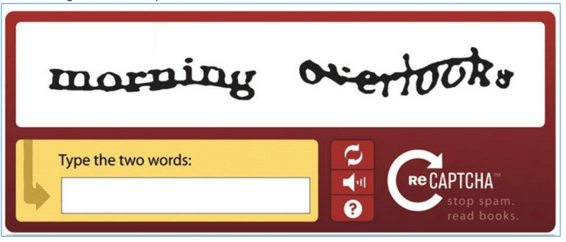

Ways to hurt abuse business
Reduce ResponseRate
Junk folders
Restrict Content (domains)
Warnings for risky content
Increase CostOfContent
Retrain quickly
Blacklist bad domains
Increase CostOfDelivery
Captchas
Throttles
Blacklist bad accounts
Blacklist bad infrastructure

Slide 8
Focus on Reputation
Use ML to find your good users & remove costs from them
Focus costs on new users
Use content based filtering as a backstop

Slide 9
Focus Features on things Abusers have to do
If you use features that abusers can change cheaply, you put them in a strong position
Text content of the SMS message
If you use features that abusers hate to change, you are in a strong position
Phone number that sent the message
Locations the SMS message is directing users
The model you build this way may not be the best OFFLINE
But it might be the best approach over time

Slide 10
Summary
Abuse is a dramatic example of a time-changing problem
Naively using machine learning works if you are small (not targeted)
Naively using machine learning fails if you are big enough (targeted)
Machine learning is an excellent complement to other techniques

